Slide 1
My Client Project
Abby Marsh

Slide 2
Riordan Clinic’s Background
The Riordan Clinic is an almost 40 year old non-profit organization. The business is focused on research and education to find an epidemic of real health. The medical clinic and laboratory treats co-learners (patients), based on natural therapies and IVC that the Riordan Clinic research has provided. The Riordan Clinic also provides scientific findings that utilize proven natural therapies. The business provides services to co-learners all over the world, and to patients who want to discover the underlying reasons for their chronic conditions, not just treat the symptoms.
A challenge that my client has faced within the marketing department at the Riordan Clinic is that it is a non-profit organization which means all of the funds come from donations, and if there are not enough funds then is becomes difficult to pay for advertising.

Slide 3
Where My Client Was When I Started vs. Now
Before I started working with my client for this class, the Riordan Clinic had pretty much every single social media a business can have: LinkedIn, Twitter, Instagram, Facebook, Youtube, and Google plus.
When I first started working with my client, the Riordan Clinic’s Twitter had 412 followers and 958 tweets. The last tweet they had made was in July of 2016 and now is up-to-date and has 425 followers with 979 tweets.
Instagram had 360 followers and 135 posts. The last post they had made was also in July of 2016 and is now up-to-date and has 375 followers with 157 posts.
Facebook had 4,989 followers and 5,070 likes. Before working with my client, Facebook was their main platform so it was always up-to-date, and now has 5,044 followers and 5,131 likes.

Slide 4
Strategies I Had for Each Platform
When beginning to work with my client, she asked that I only focus on Twitter, Instagram, and Facebook (those were also the only login credentials she provided me). So, I came up with a few different strategies for each platform.
Twitter: post more & give more feedback to accounts that tag the Riordan Clinic in tweets, retweet/favorite more accounts to gain more followers.
Instagram: post more and use more hashtags that draw in customers/followers. Idea: maybe post pinterest pins (workouts/ healthy recipes)
Facebook: Reply to more comments and give feedback

Slide 5
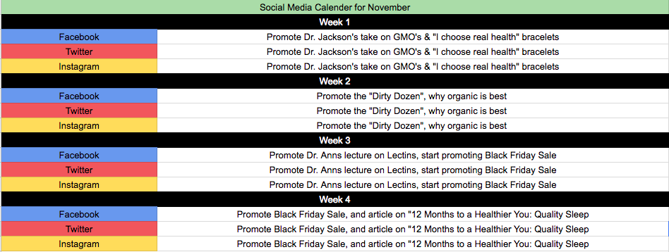
Social Media Calendar for November

Slide 6
Moving Forward
Any strategies that I have moving forward are pretty similar to the strategies I had before. I won’t be working with the Riordan Clinic after this semester because the marketing department already has employees who update all social medias.

