Slide 1
Online Reputation Project
Abby Marsh

Slide 2
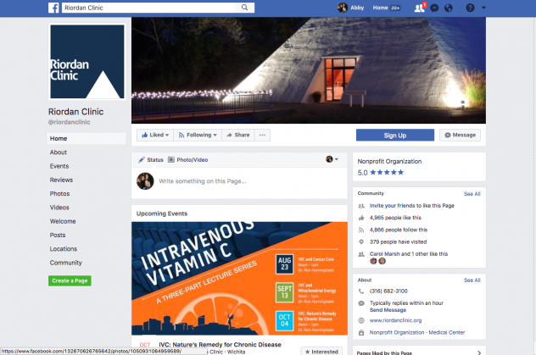
Online Presence Before Getting Started, Facebook:
Likes: 4,995
Followers: 4,866

Slide 3
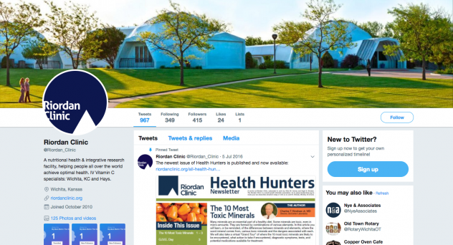
Twitter:
Tweets: 967
Following: 394
Followers: 415
Likes:24

Slide 4
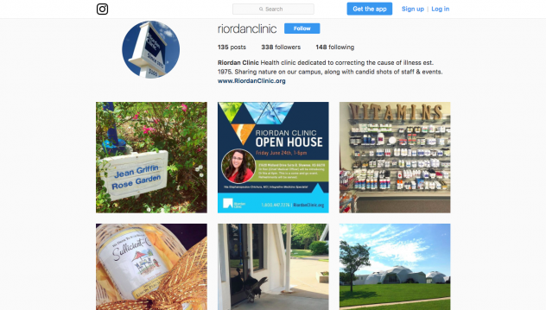
Instagram:
Posts: 135
Followers: 338
Following: 148

Slide 5
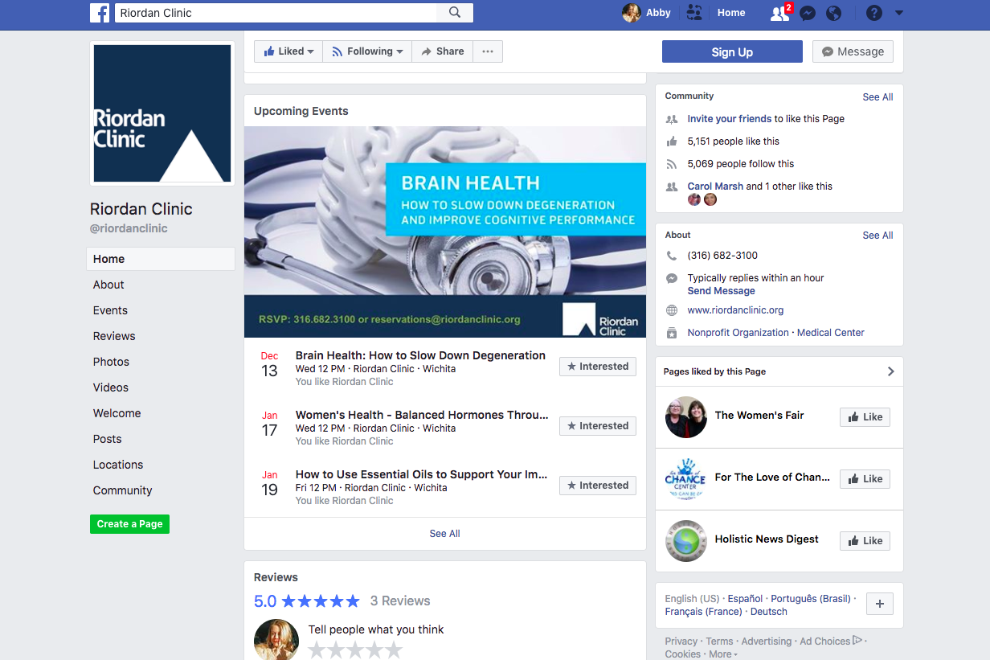
Online Presence Now, Facebook:
Likes: 5,151
Followers: 5,099

Slide 6
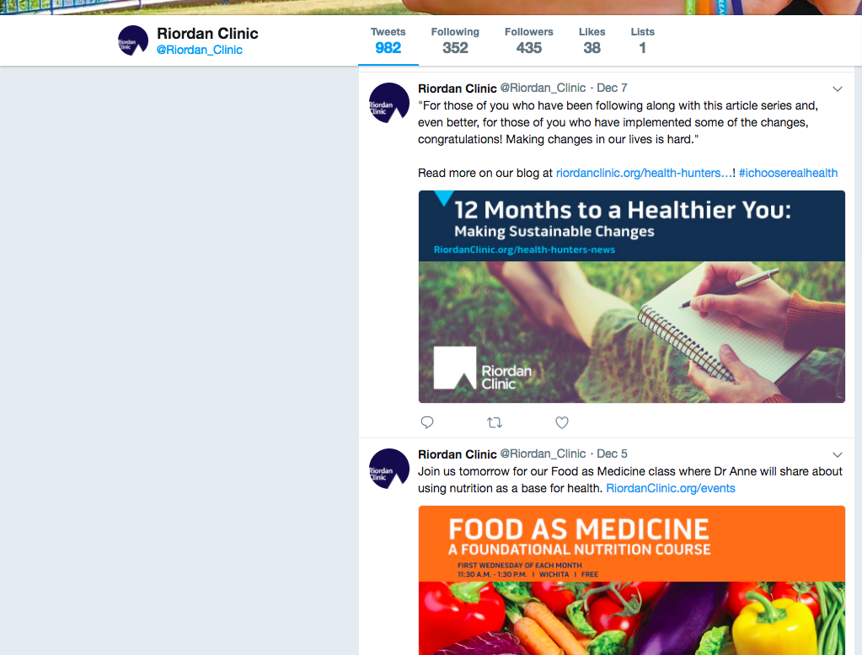
Twitter:
Tweets: 982
Following: 352
Followers: 435
Likes: 38

Slide 7
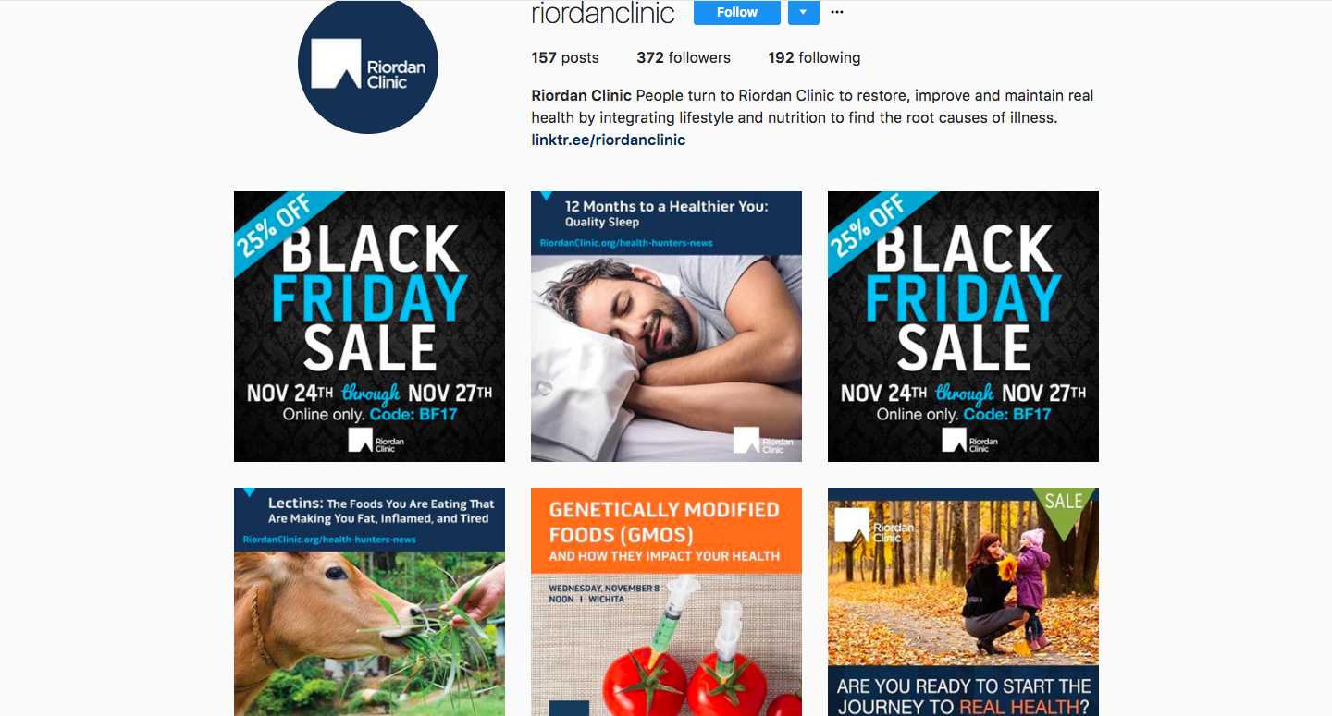
Instagram:
Posts: 157
Followers: 372
Following: 192

Slide 8
Results:
I am pretty satisfied with the results of my effort to post more on these social media accounts. I feel like my strategies for each social media were effective because the posts got the attention they should have, and each of these three platforms have gained a numerous amount of followers and likes.
When it comes to the progress that the Riordan Clinic’s Twitter and Instagram has made, I am very pleased. Before I started working on these accounts there had not been a post made in over a year. Now, the accounts are being regularly updated and because of that we have gained followers!

Slide 9
Challenges:
Throughout this semester I have had many challenges within this class particularly. The main challenge for me was living 3 hours away for the organization I was working for. That made it hard for me to know what was going on at all times within the Riordan Clinic, and what to post. Thankfully, Erin, the director of marketing kept me in touch with her assistant who kept me up to date with what I should be posting.

