Slide 1
CLIENT PROJECT—
BLUME & Co. creations
AMY BETH BLUME

Slide 2
Background
Blume & Co. Creations started out as BB Embroidery with 93 Facebook followers. BB Embroidery specialized in embroidered personalized items. Since that time the business has evolved into more vinyl based projects and the name no longer fit, so we decided to change the name to something that could encompass both creative avenues, with knowledge that the main thing the client is trying to push are vinyl based projects.

Slide 3
benchmark
Blume & Co. Creations/BB Embroidery had only used Facebook and when this project started had 93 page likes.
Since this project has been in effect Blume & Co. Creation utilizes Facebook with 105 page likes, with some posts reaching over 200 views organically, no posts have been boosted at this point. Instagram and Twitter were both added as social media accounts and each one has a few followers but not a lot.

Slide 4
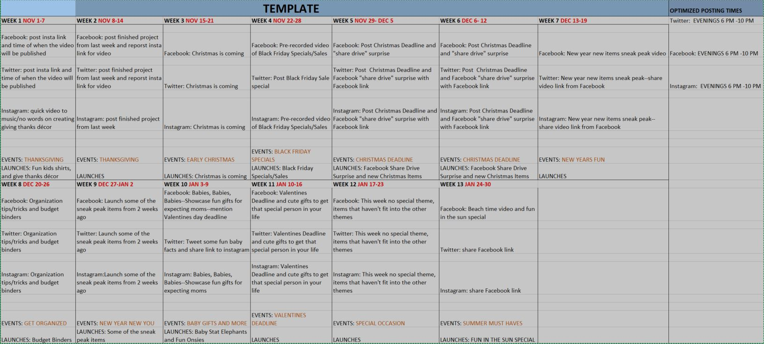
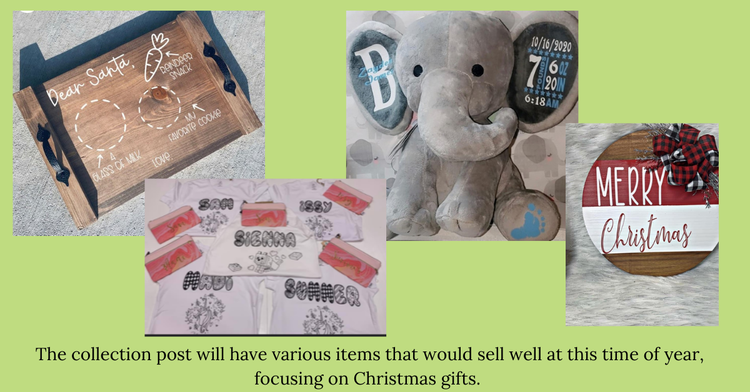
Plan/implementation
Since Facebook is the media outlet that Blume & Co. Creations is the most comfortable with, we chose to work more from that platform with the other platforms being secondary. As you can see from the editorial calendar most things are organized or shared from Facebook, with links being shared for the other social media platforms. With regards to boosting, we will of course boost items between the platforms of Facebook and Instagram.

Slide 5
Results
As you can see from the chart, since the client originally had Facebook before the project they already had some followers, however they were able to add some additional followers through the project. Instagram and Twitter were introduced with this project and the client did receive some followers on those platforms but not very many.

Slide 6
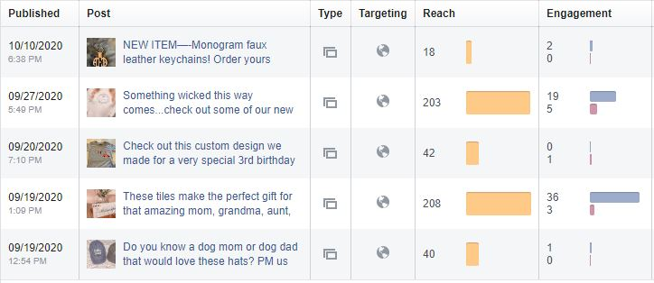
RESULTS/ANALYZE
As we analyze the results of different successes of this project I would like to point out that without paying for boosting posts, Blume & Co. Creations, organically reached over 200 people with their posts and had more engagement with those specific posts as well. So when discussing future posts the suggestion would be to utilize the information in deciding what to run also utilizing the data from the times and days of the week that the higher reached posts were added.

Slide 7

Moving forward
My recommendation for Blume & Co. Creations would be to post more often. While it is very difficult sometimes to spend the finances to make items that are generalized so that you can show new creations, sometimes you need to weigh the money in vs money out and decide if those items would be worth it to make so that you can showcase more. I would also suggest to utilize the data from Facebook and see what items received more attention and at what times those items were posted. I feel that since Facebook and Instagram speak to each other there is no harm in keeping both going, but I think that Twitter might be difficult to maintain and would suggest a website vs. Twitter.

