Slide 1
Client Presentation
By: Fariba Soleymanzadeh

Slide 2
Intro
Flowerama is a leading florist in Overland park that offers professional flower arrangements and gifts for any occasion.

Slide 3
Objective
The main objective of Flowerama is to fulfil the customer’s wants and give them better products with affordable prices so that customer will satisfy.

Slide 4
Social Media Websites
Facebook
Twitter
Instagram

Slide 5
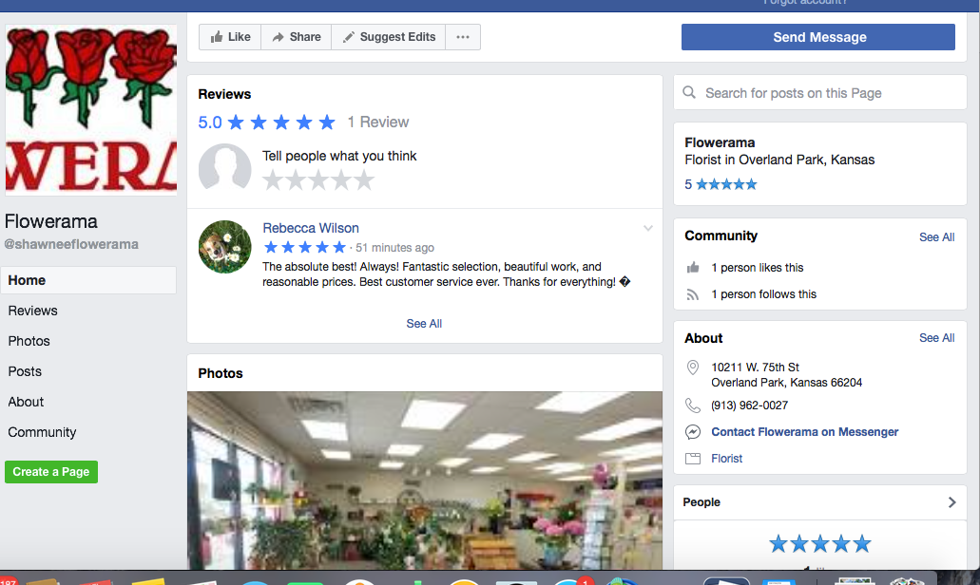
Facebook
Facebook was the first social media site I created for my client. I keep it updated this page so my client can receives more likes and followers. So far this page is rated 5 star with a positive review comment.
Last updated: April 18, 2018
( added new image)
Likes: 1
Followers: 1

Slide 6
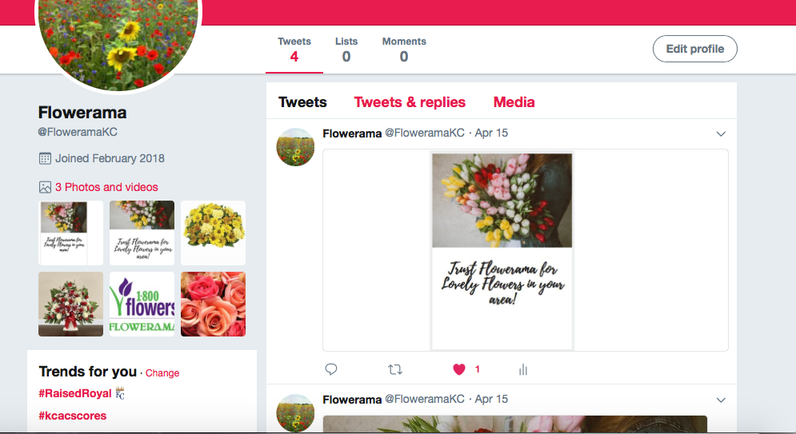
Twitter
This Twitter page I created for my client needs to be frequently updated. I plan to update this page at least 2 times a week so my client can receive more likes and followers. I am still working on it!
Updated: April 15
Likes:1
Followers: 2

Slide 7
Instagram
So far my client is receiving 22 followers. However, I have to be more active and update this page frequently in order for more people to like, and follow this page. I plan to update and post on this page at least 2 times a week.

Slide 8
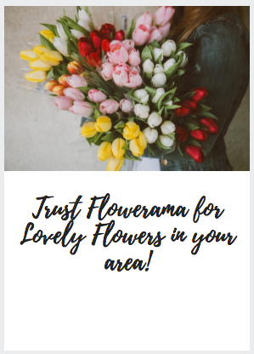
Plans
I plan to have more people like and follow these pages, by frequently updating and posting on these sites.

Slide 9
Moving Forward
Thing I would recommend:
Be more active on social media sites.
Keep updating and posting on your page.
Focus on attracting new customers.
advertise your products online, in stores, social media pages ( Facebook, Twitter, etc)
Read your audience’ comments about your products.

