Slide 1
MY CLIENT PROJECT
Angela Nicole-Herbalife Distributor

Slide 2
Client Background
My client is Angela Nicole and she is an Herbalife distributor & Health Coach. Her focus is to share her knowledge and passion for fitness and health through exercise and healthy meal supplements. Her target audience is wide spread between men and woman of all ages.
Angela is a single mom of three and works a full-time job on top of working her business with Herbalife. Balancing her life and business can be challenging at times, but she is determined to leave corporate America and be doing Herbalife full-time by the end of 2019.

Slide 3
Benchmark February 2019
When I first started working with Angela back in February, she had a personal Facebook with a page designated for her business, an Instagram account, and LinkedIn and YouTube that she hadn’t accessed in over 2 years. I began by completely updating her profiles on LinkedIn and YouTube, then revised her Facebook and Instagram accounts, and opened a new Twitter account. Below, you will see screenshots of Angela’s social media sites before we began working together on her branding.
LinkedIn:
49
Connections
Facebook
Business Page: 178 Likes
180 Followers

Slide 4
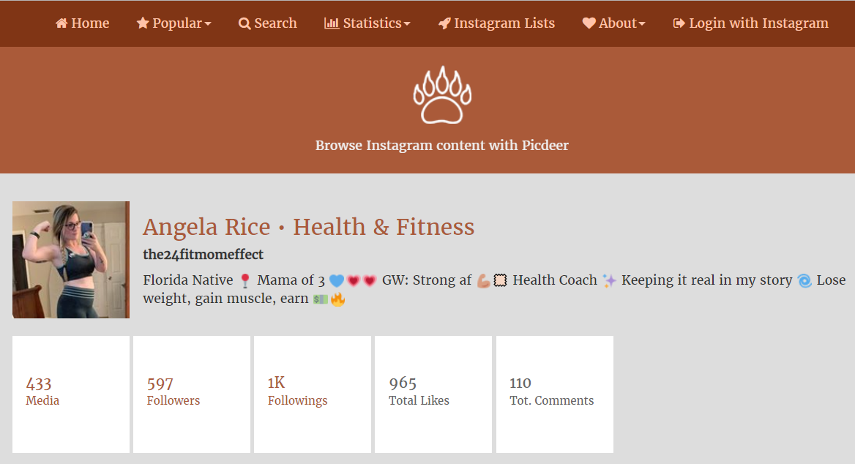
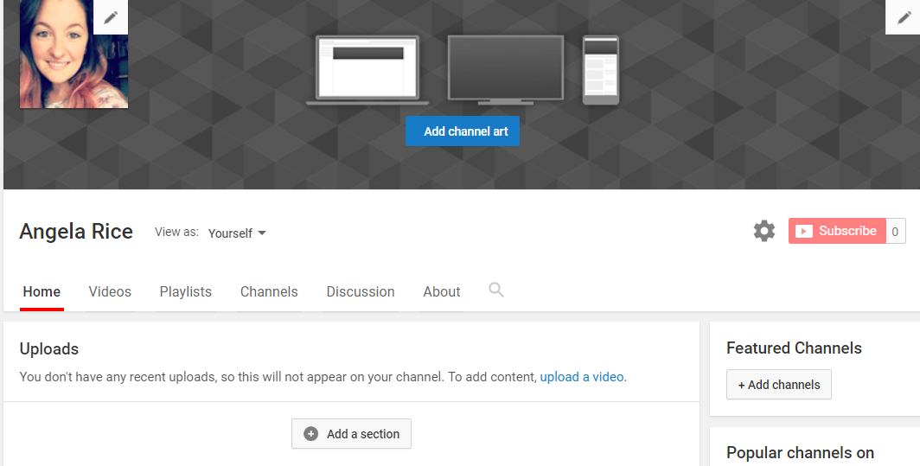
Instagram
Followers
597
Total Likes 965
Followings
1,000
YouTube
No Activity

Slide 5
IMPLEMENTATIONS
FACEBOOK
Add meal prep/shake videos weekly
Tag local businesses and events
Weekly-ask followers what they want to see
Engage with audience daily

Slide 6
IMPLEMENTATIONS
TWITTER
Log in at least 3 times a week
Use Analytics weekly to see what’s working and what’s not
Stay engaged with your audience
Add 5 new followers a week

Slide 7
IMPLEMENTATIONS
Instagram
Use 3 new hashtags a week
Post 2-3 times M-F during target times
Tag 5 relevant users weekly
Grow Followers to 1000

Slide 8
CONTENT CALENDAR

Slide 9
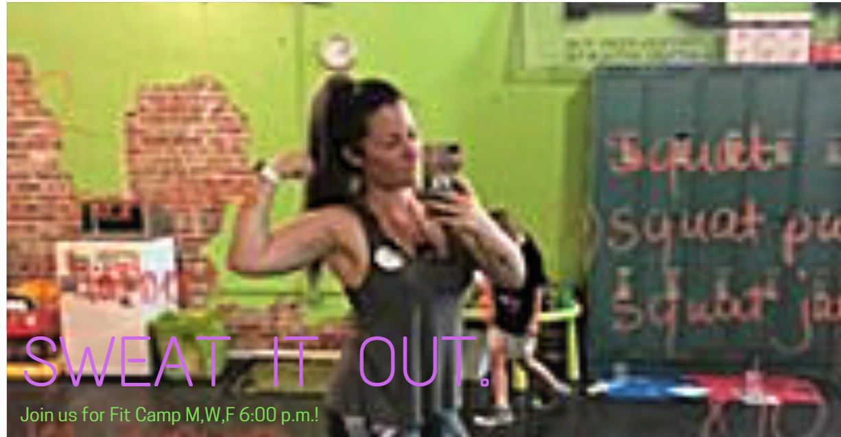
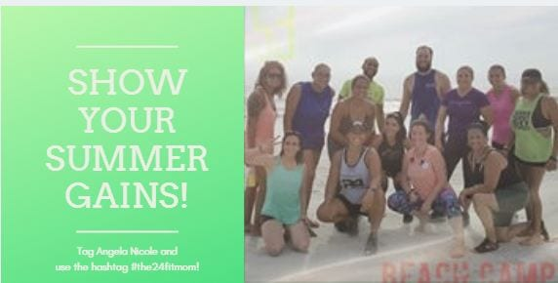
MOCKUP ADS
FACEBOOK
TWITTER
LINKEDIN

Slide 10
RESULTS FOR FACEBOOK
Followers 22
Post Reach 90%
Engagement 22%
Video Views 183%
Page Views 40%
The biggest improvements we saw were on Angela’s business page. Being engaged daily with her followers, posting more videos, and running special offers really made the difference!
https://www.facebook.com/angelanicole24fit/

Slide 11
RESULTS FOR TWITTER
This is a newly established account that Angela and I set up when we started working together. It didn’t grow as much as we would have liked it to, but with more time and activity, I believe she will continue to see more growth.
https://twitter.com/the24fitmom

Slide 12
RESULTS
Increased Followers by 159
Added 1339 Followings
Added 18
Connections
https://www.instagram.com/the24fitmomeffect/
https://www.linkedin.com/in/angelanicole24/

Slide 13
MOVING FORWARD
RECOMMENDATIONS
Continue engaging with your audience daily. Like and share their posts.
Your videos grab people’s attention, so do as many a week as possible. For example, meal prep, making shakes, fitness, and success stories.
Don’t be afraid to ask your audience what they want to know about. Pick a day a week to focus on that topic through your posts and videos.
Continue to browse through your competitor’s social media sites to see what’s working for them and implement it yourself.
Do a monthly analysis on your networks to see what’s working and what’s not and readjust accordingly.
Hootsuite Dashboard would be a great resource for you to keep your accounts more manageable and save you time.
If you don’t chose to use Hootsuite, find a Content Calendar that will work for you in planning out your daily, weekly, and monthly social media activities.
Prepared by: Melissa McCloud

